Slide 1
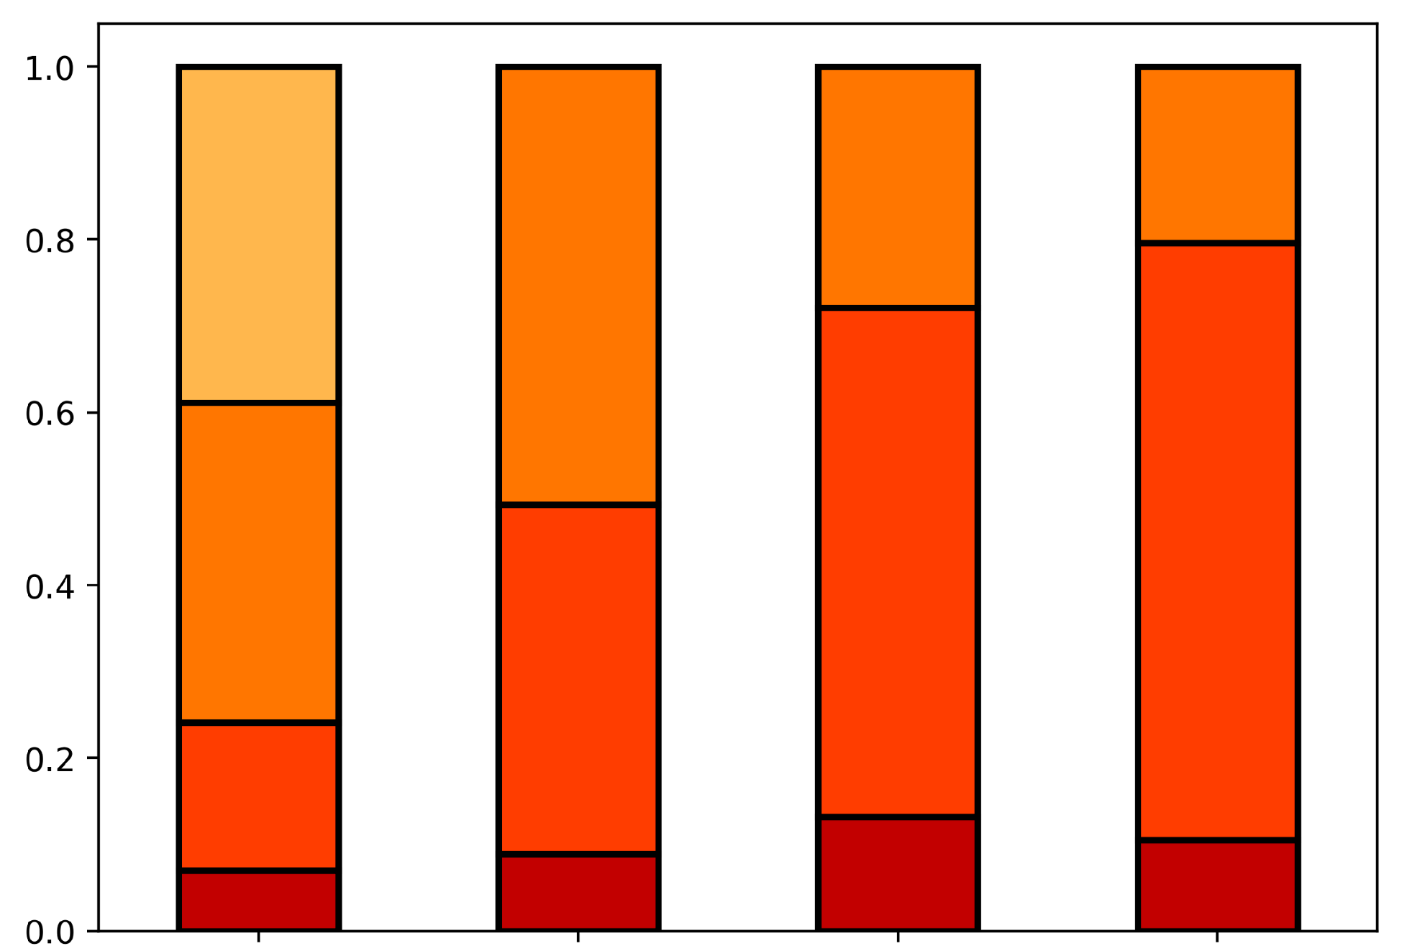
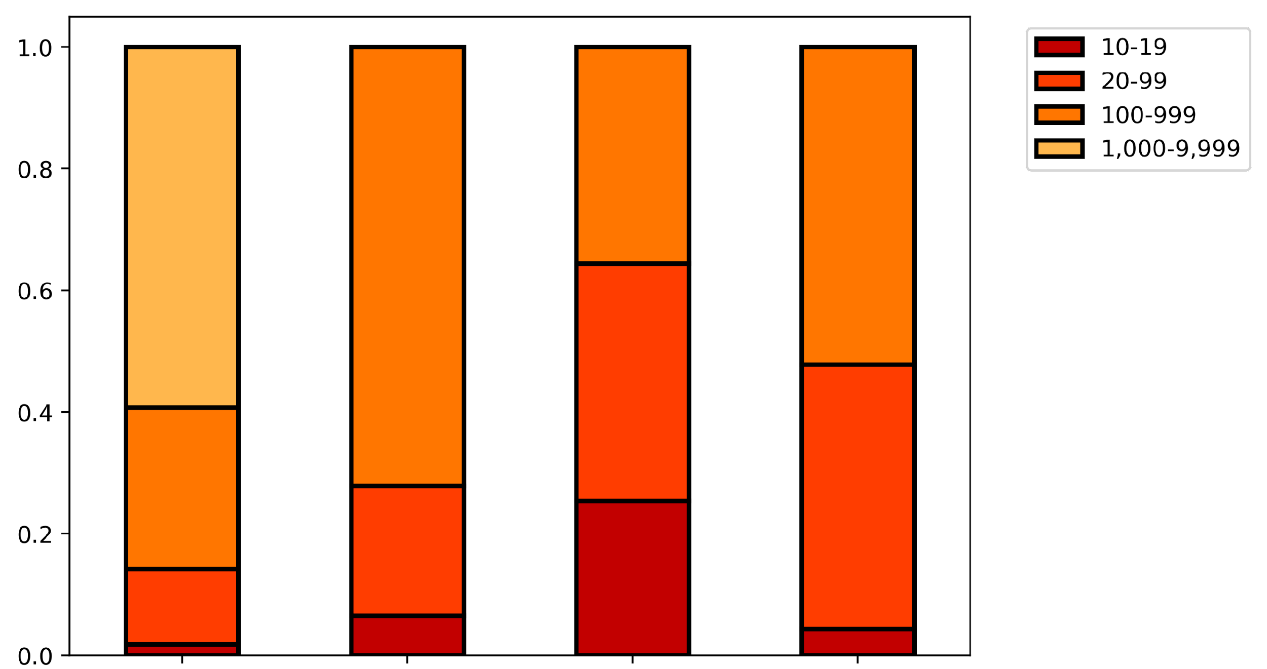
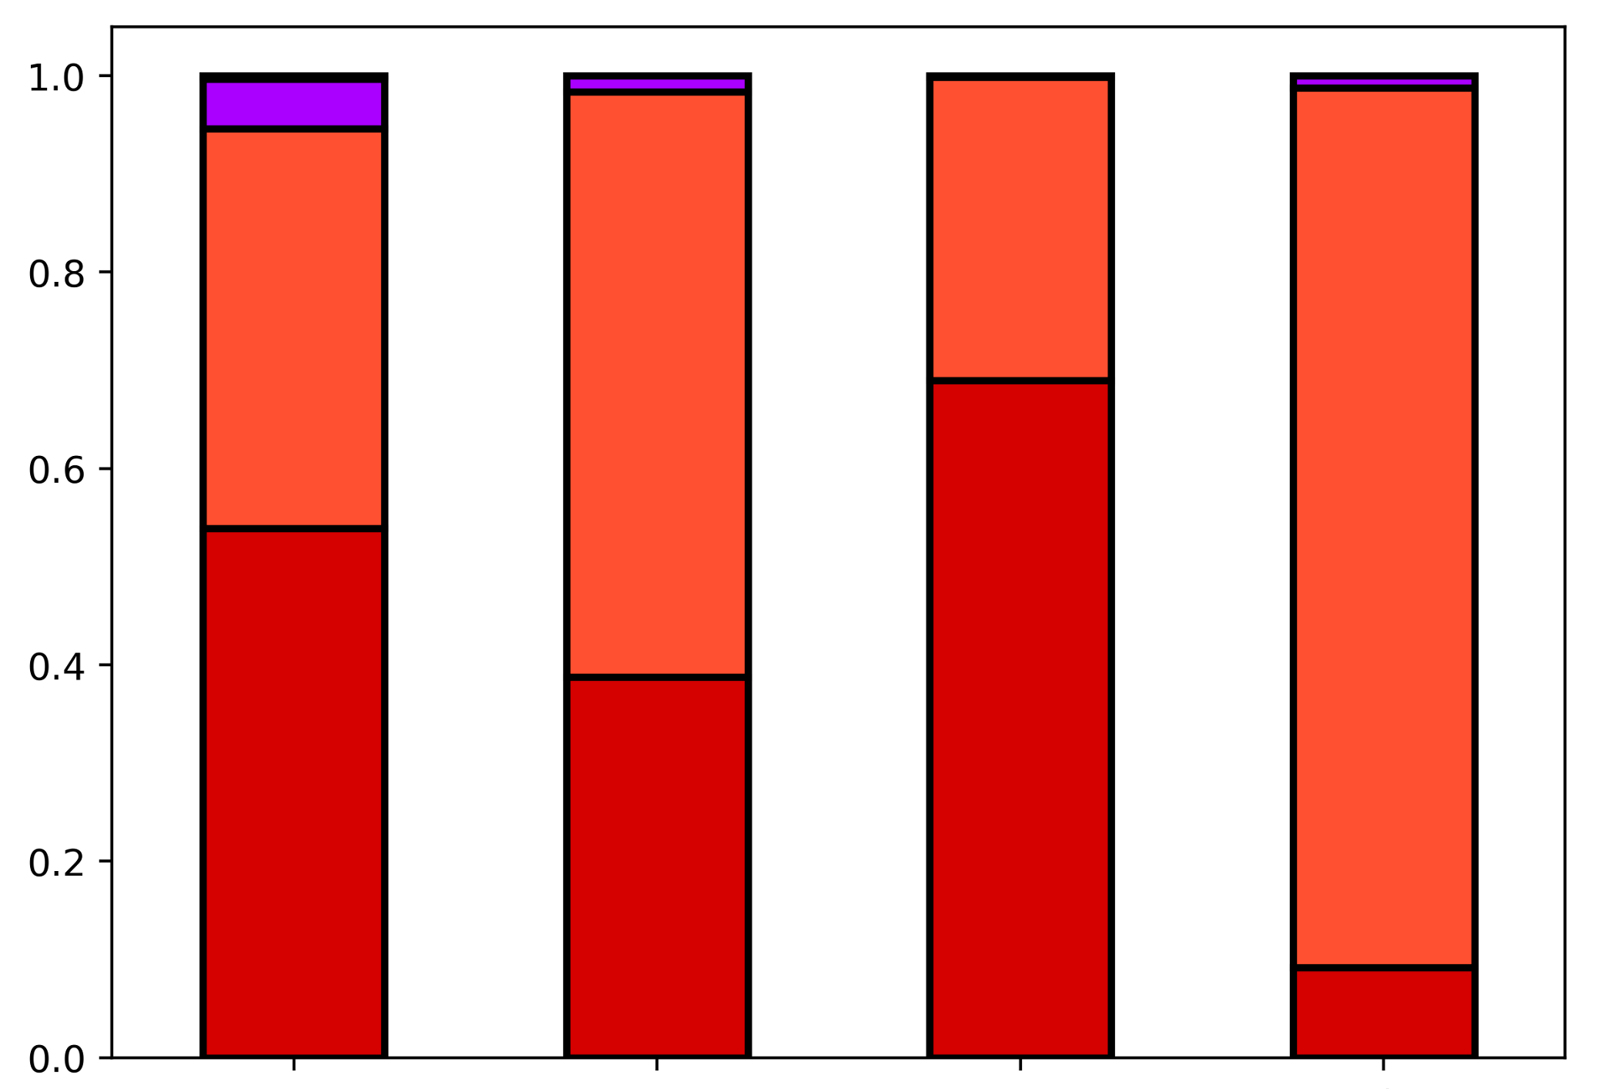
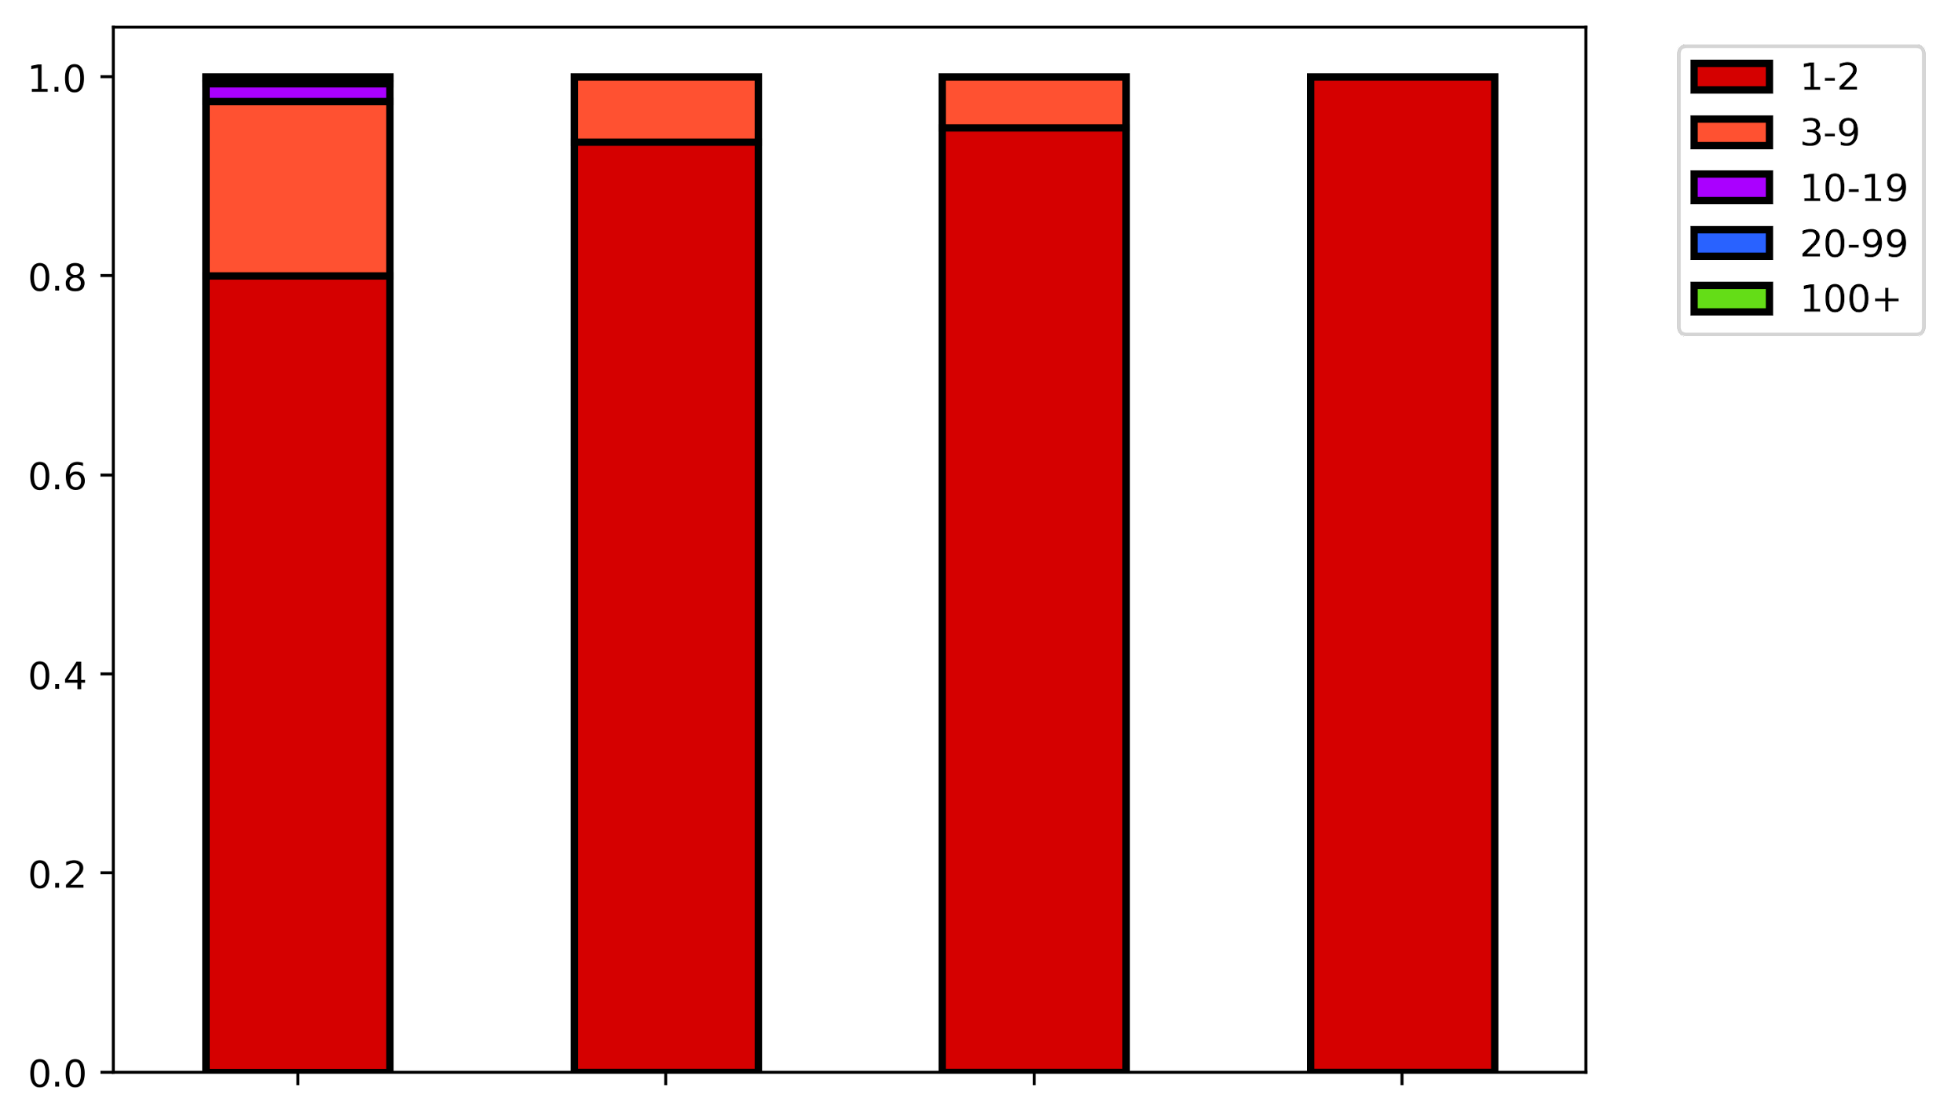
A
Before C-cutoff
After C-cutoff
ERCC p-m5C site coverage
MT-A
MT-B
MT-C
MT-D
MT-A
MT-B
MT-C
MT-D
ERCC m⁵C artifacts
MT-A
MT-B
MT-C
MT-D
MT-A
MT-B
MT-C
MT-D
Notes:
(A) Read coverage and m5C artifact count at ERCC positions. Values are binned according to legend.

Slide 2
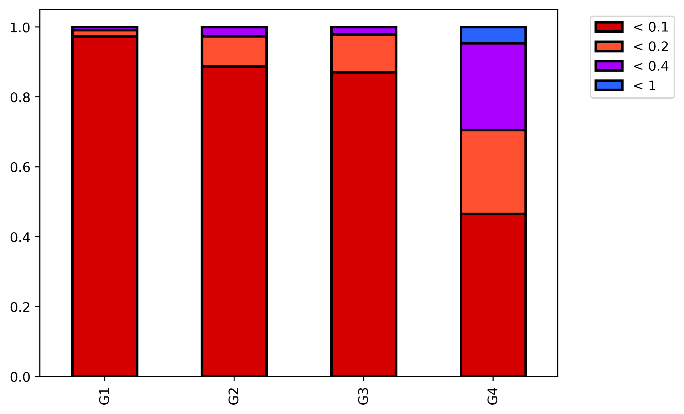
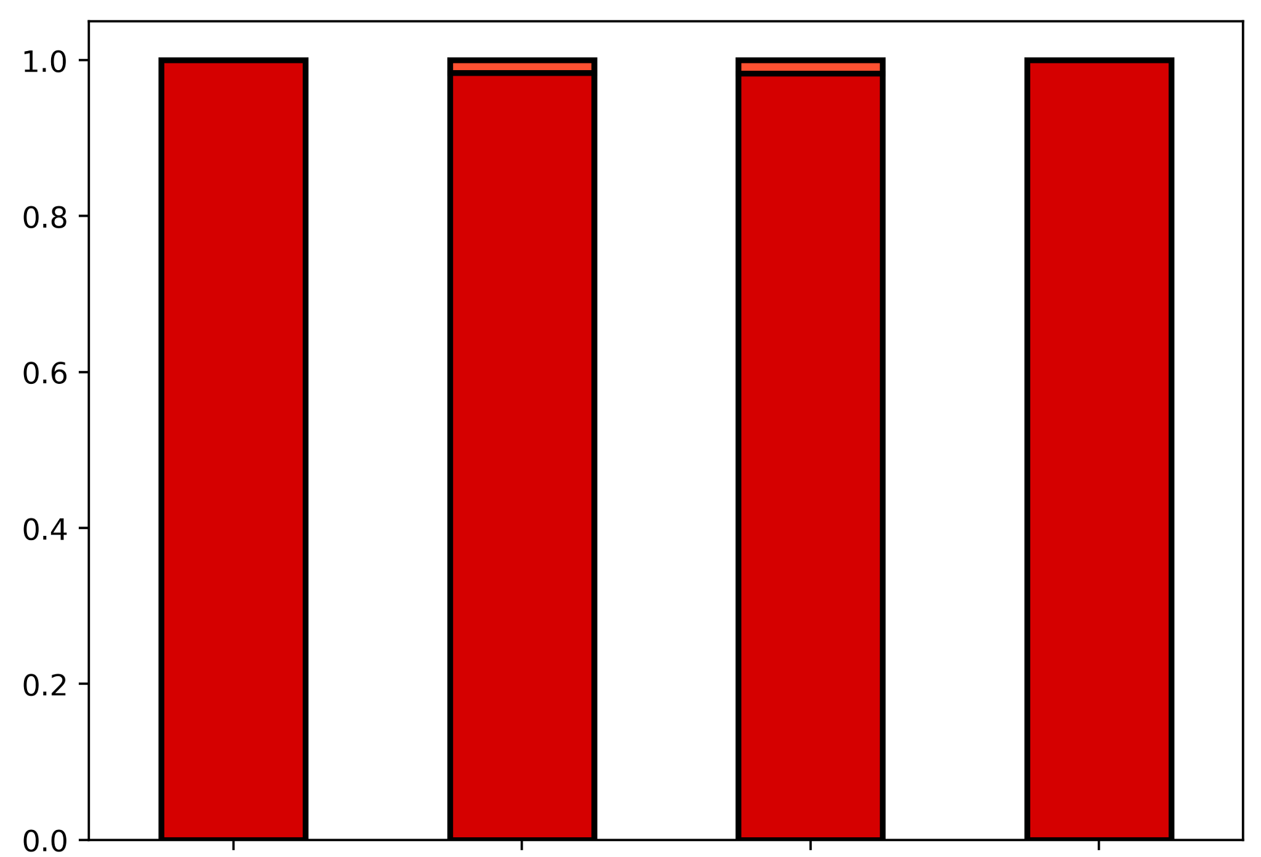
Before C-cutoff
After C-cutoff
p-m⁵C artifact ratio
MT-A
MT-B
MT-C
MT-D
MT-A
MT-B
MT-C
MT-D
Notes:
(C) m5C artifact ratio at ERCC positions. Values are binned according to legend.

